Slide 1
MALEEHA MAZHAR
GRAPHICS DESIGN
P.NO 03201155965
Gmail.mfr272911@gmail.com

Slide 2
GRAPHICS DESIGNING PROJECT PERCIOUS PEARL PERFUME
The name of my project is Precious Pearl Perfume.
The color theme consist of confederate,maximum Yellow Red,Sun, Orange,Rough and Black wash
#5D6473#F2B84B#F28D35#A65132#ODODOD#C28D52#be872a
Using Software adobe illustrator and Adobe Photoshop

Slide 3
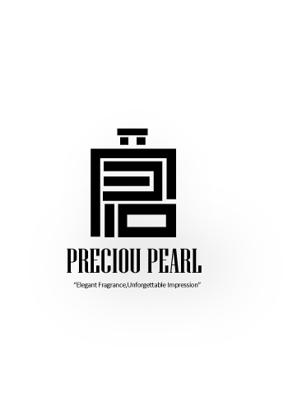
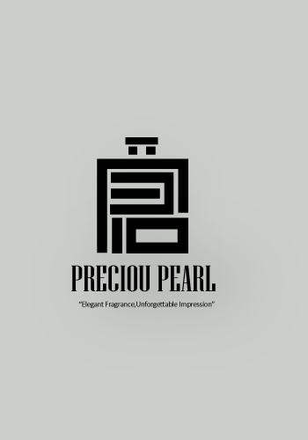
LOGO DESIGN
USING ADOBE ILLUSTRATOR
SIZE 320 x 500 px
PRECIOUS PEARL
The tagline of my project is
“Elegant Fragrance,Unforgettable
Impression”
Font Niagara Solid
Aobe illustrator

Slide 4
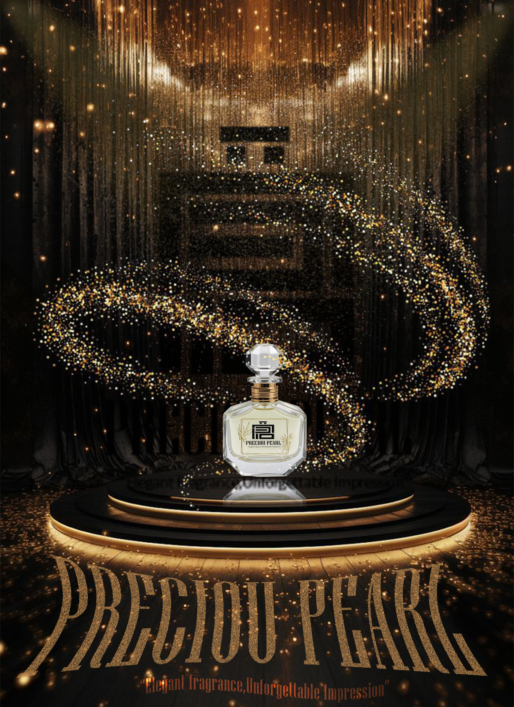
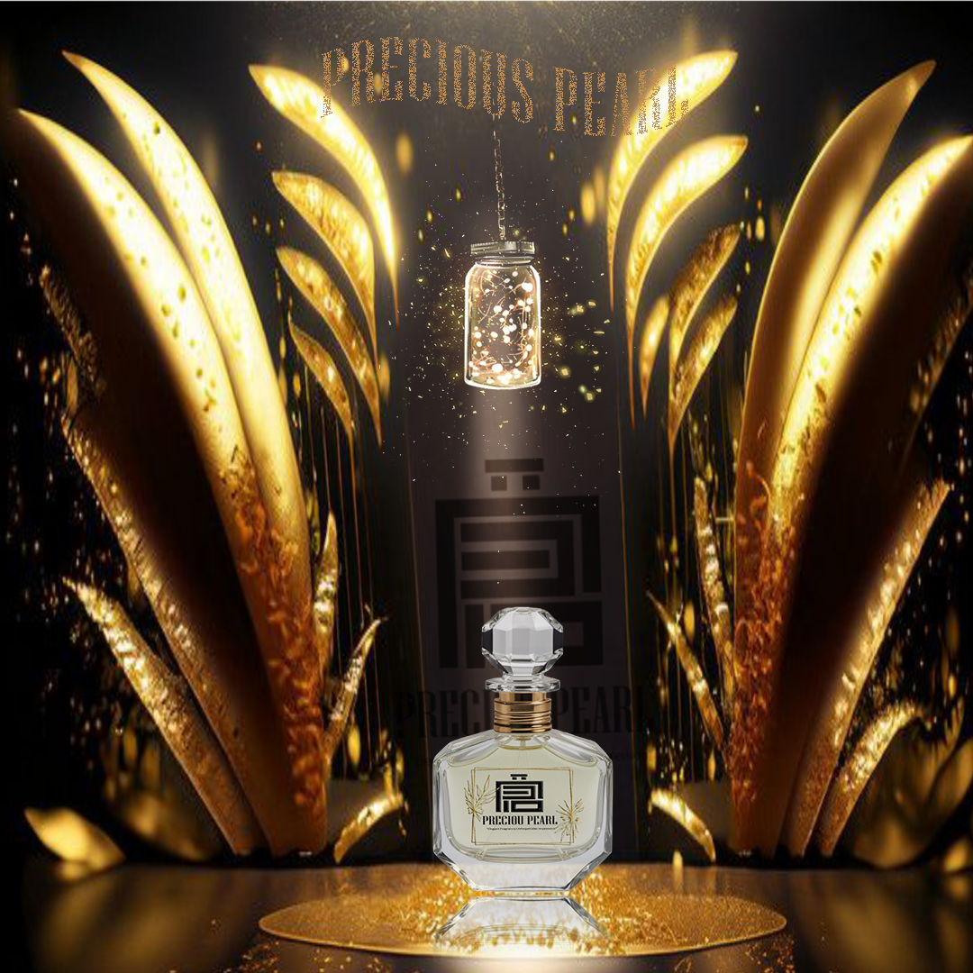
Social Media graphics
1#1920/1080px and 2# 1080px/1080px
Typography Niagara Sold

Slide 5
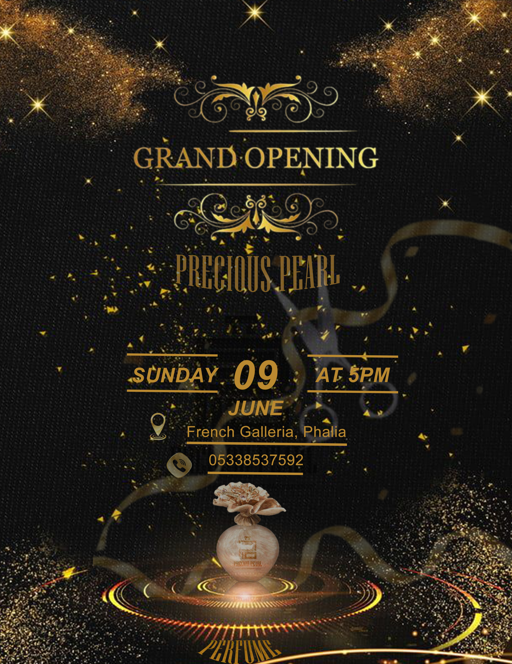
EVENT FLYER
Size 1080px/1080px
Adobe photoshop

Slide 6
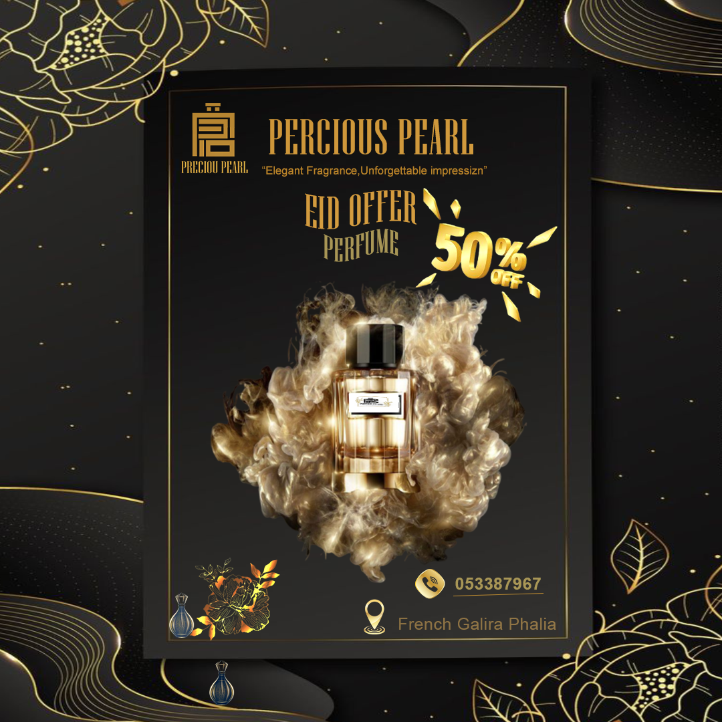
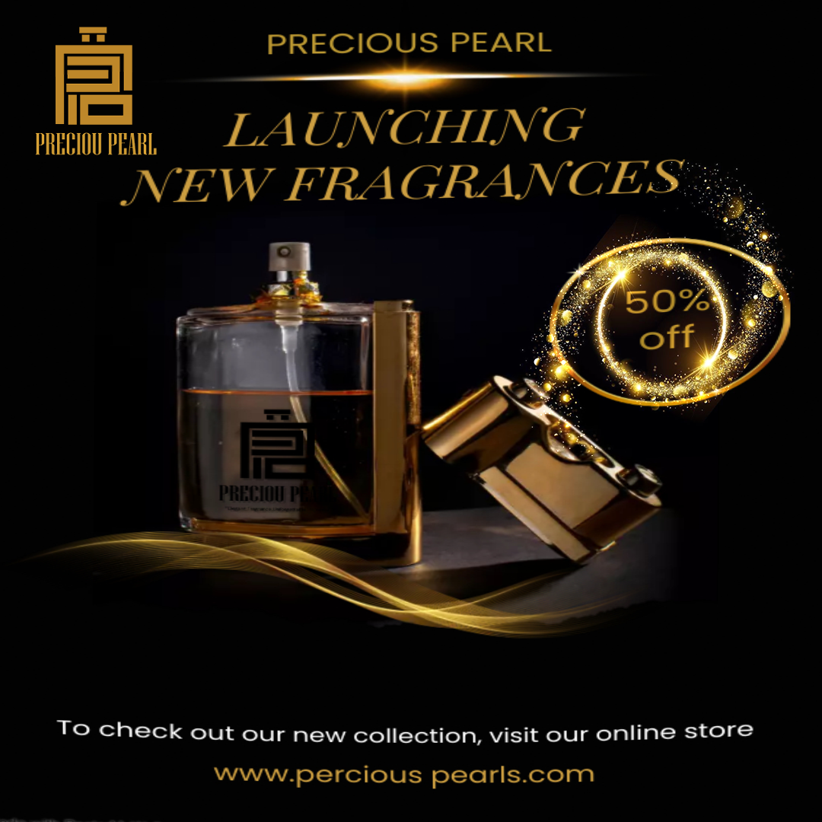
Brand Identity pacage
Size 1080px/1080px
Adobe photoshop

Slide 7
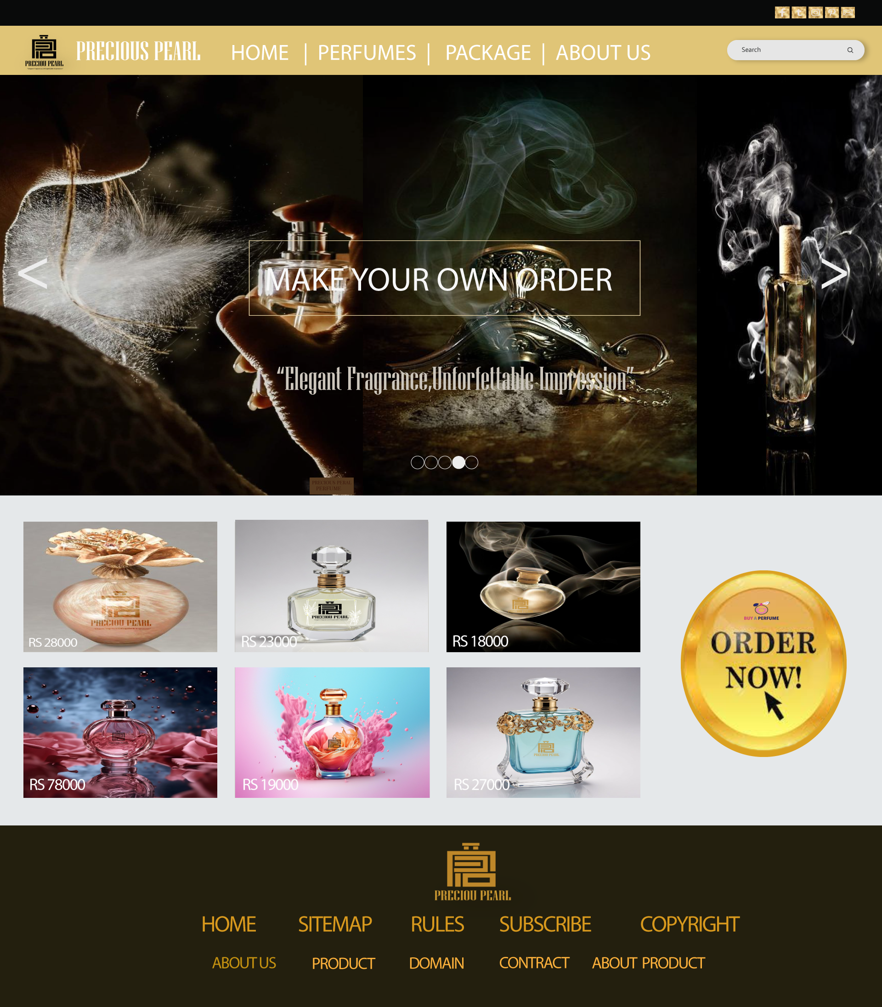
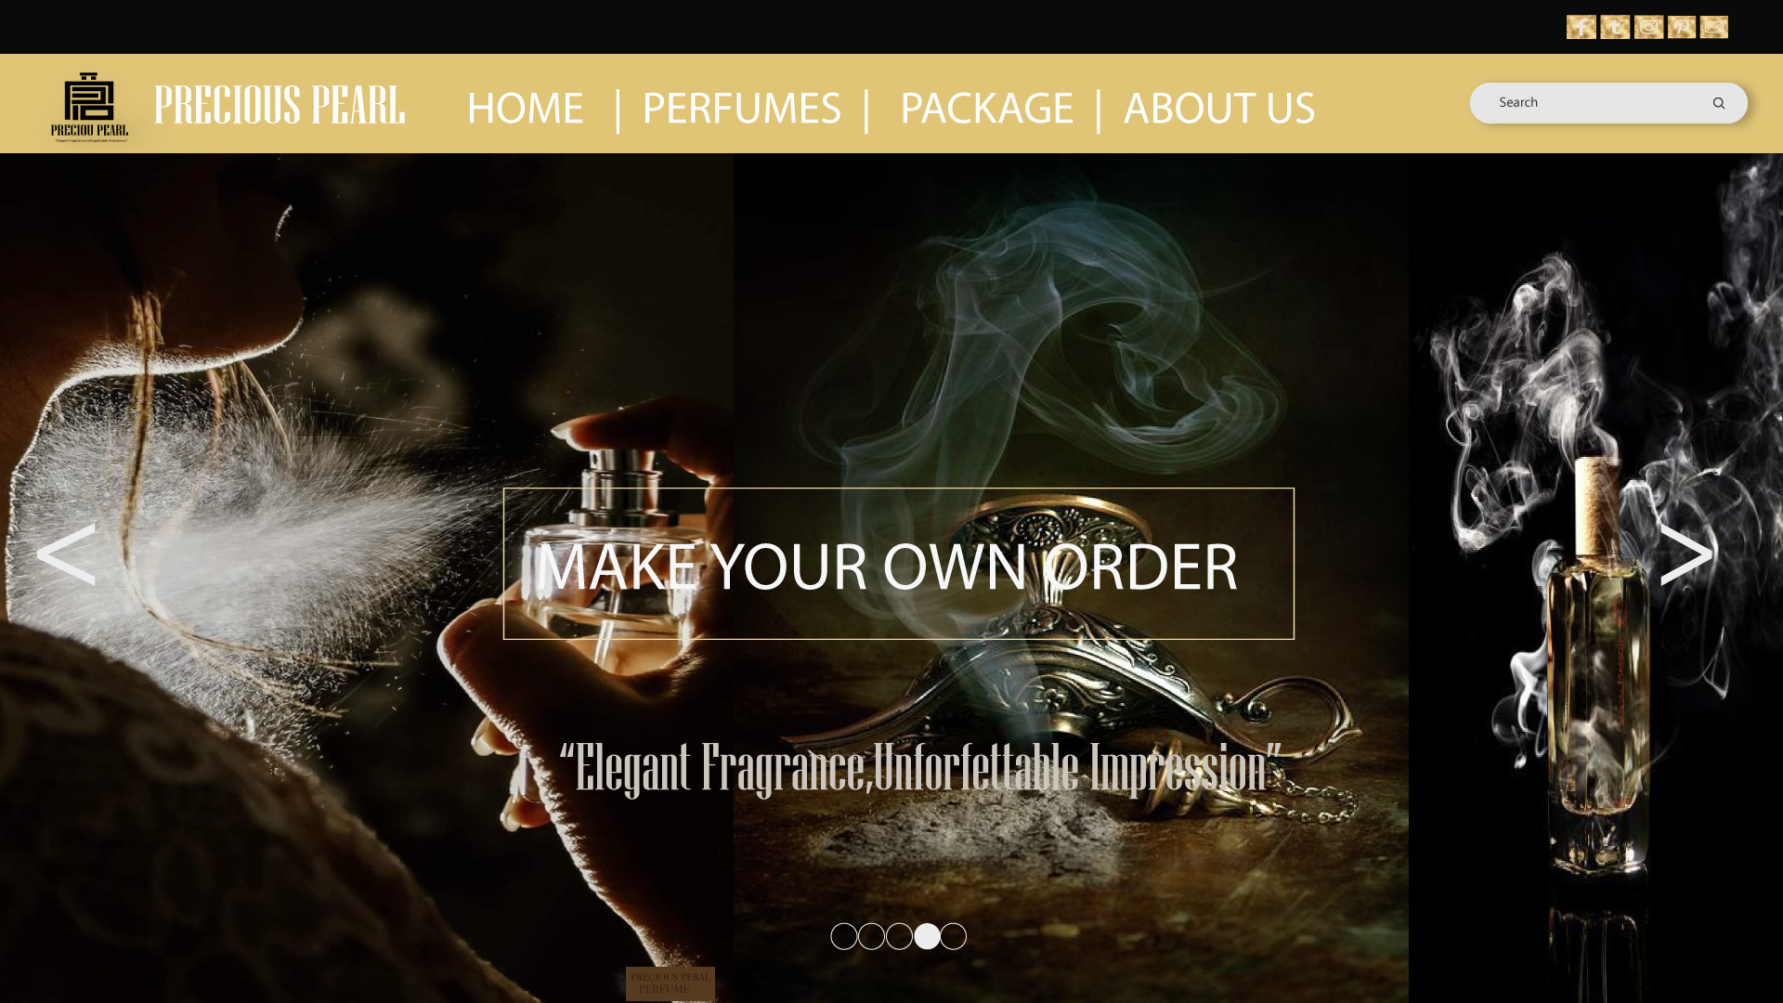
Interactive Web Graphics
Adobe photoshop

